Slide 1

America in the 1960‘s

Slide 2
content
Political events/wars
Conflicts in America
Scientific developments
Sexual revolution
Anti- war movement
Feminism
Music and Drugs

Slide 3
Political events/Wars
Cold War
Construction of the Berlin Wall begins in 1961
the Vietnam War (1955 – 1975, with direct US-intervention beginning 1962) reaches its climax, with up to 500,000 US-Soldiers deployed
JF Kennedy is elected US-president in 1960.
Highlights of his presidency are:
The American invasion of the Bay of Pigs
The Cuban Missile Crisis
his famous speech in West-Berlin
Kennedy was assassinated on Nov. 22nd, 1963

Slide 4
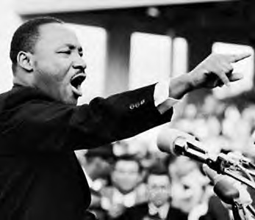
Conflicts in America
Personalities:
Martin Luther King Jr. : non-violent civil rights and anti-segregation movement.
March on Washington : Jobs & Freedom (Aug. 28th, 1963) →200.000 participants
„I have a dream“-speech: at the Lincoln Memorial
King was assassinated on April 4th, 1968

Slide 5

Conflicts in America
Malcolm X :
→the pan-african and black pride movement
→opponent of Martin Luther King
→Adaptation of the name „X“ as symbolic gesture
→Top minister in the Nation of Islam and work with other black
nationalist organizations
Malcom X was assassinated on Feb. 21st, 1965
→ by three members of the Nation of Islam

Slide 6
Scientific Developments
Space Exploration – The Space Race:
Space Race:
→Competition between the United States and Soviet Union for supremacy in outer Space Exploration
Technological goals:
→Launching satellites, sub-orbital and orbital human space flights around the earth, piloted voyages to the moon
American Dream: expand frontiers of the United States (East to West; Earth to Space)

Slide 7
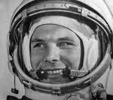
Scientific Developments
Timeline:
Soviet Union launches the first satellite called Sputnik 1 into the
lower earth orbit in October 1957
First Human in Space → the Soviet Yuri Gagarin
20th of April 1961:
→President Kennedy announces the US would manage to land a piloted spacecraft on the moon before the end of the decade
First human spaceflight lands on the moon on July 20, 1969

Slide 8
Scientific Developments
Development of Technology as a result of the space race
Great progress in the fields:
aerospace engineering,
telecommunication
electronics
Rocketry, physics, astronomy
Boom of mathematics and physics in education worldwide
→ Following educated scientists developed many technologies

Slide 9
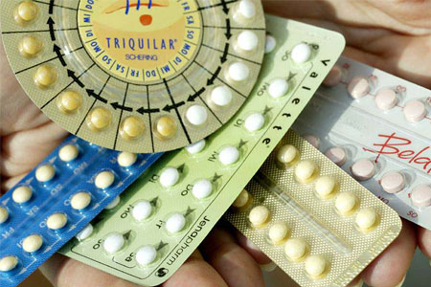
Scientific Development
Other Developments
female birth control → the pill
First heart transplantation by a South African professor
Car Boom:
new styles
“horsepower race”
highest sales of the “Big Three”
introduction of the size categories: compact, mid-sized and full-sized cars

Slide 10

Scientific Developments
Invention of the first:
laser
video game
video recorder
color TV broadcast
automatic teller machine
prototype of the Internet
e-mail

Slide 11
Anti-war movement
Increasing US losses in Vietnam
→unrest in the population.
millions of Americans protested against US involvement in Vietnam
ways of protest:
→peaceful demonstration
→suicide
nationwide moratorium (1969)
→more than 500,000 participants

Slide 12

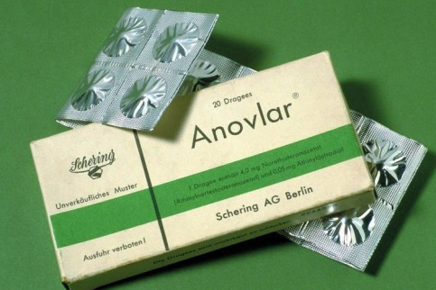
Feminism
What is feminism?
Feminists have always argued that women should have complete control over their own bodies
Abortion
Birth Control Pill

Slide 13


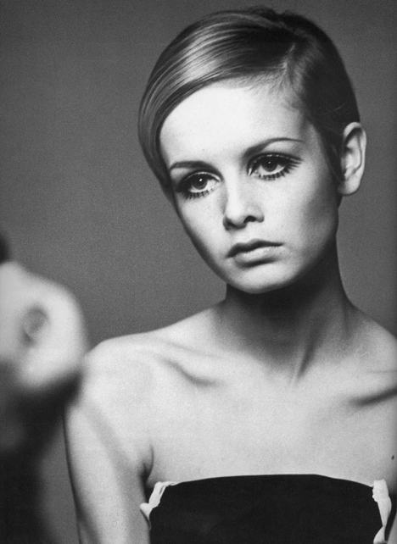
Feminism
Feminist:
Judy Chicago
→ Art and Film
→ Organizations
→ Models

Slide 14
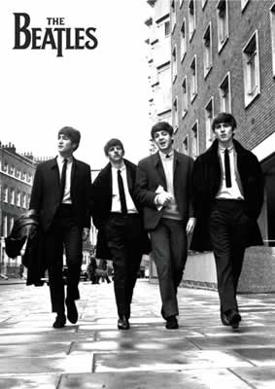

Music and Drugs
first hit records
→radio stations - played only the most popular songs
Counterculture movement formed top genres: folk rock, soul,pop, reggae, blues music
first jams: long, made-up sections
Influences : hippie culture, drug culture
Significant events in music in de 1960’s:
Elvis Presley
Bob Dylan
The Rolling Stones
The Beach Boys
The Beatles
Pink Floyd

Slide 15
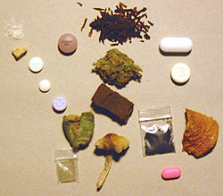
Music and Drugs
Drugs :
→ popular, especially for young people listening to rock music
→ influenced by musicians e.g. The Beatles , Jimmi Hendrix
4 most common drugs:
marijuana
amphetamines
psychedelics
LSD
drugs influenced music, art, style and philosophy
government developed new laws and agencies
→laboratories stopped its still legal shipments

